Slide 1

Introduction to Robotics
CSE 461
Lecture 1: Chapter 1(Introduction to robotics: basics)
Md Toki Tahmid
Lecturer, Dept. of Computer Science and Engineering
Brac University
Thanks to-
Riad Ahmed
Lecturer, Dept. of Computer Science and Engineering
Brac University

Slide 2
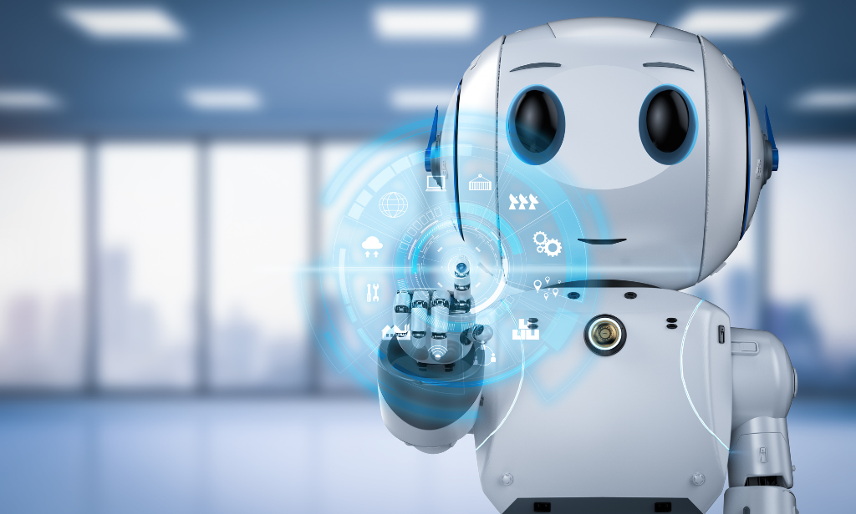
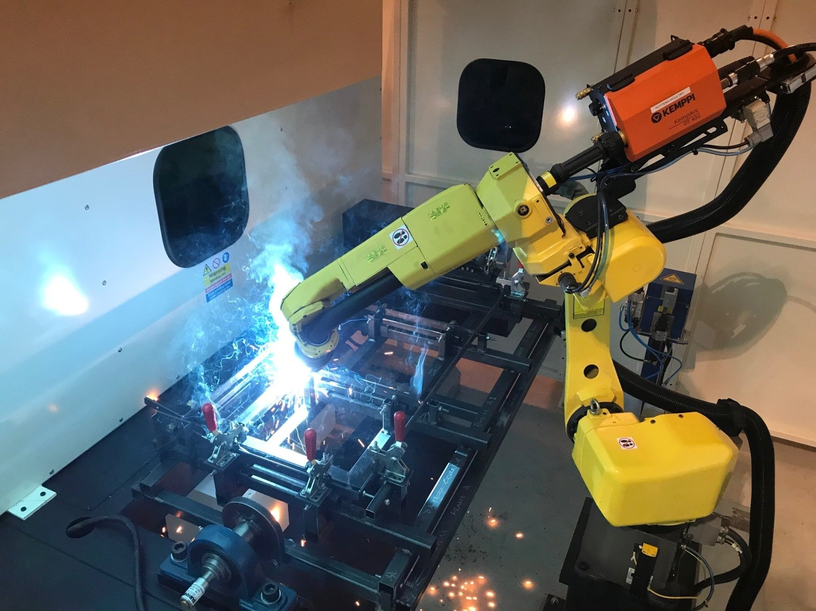
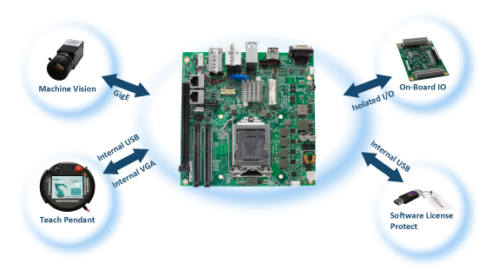

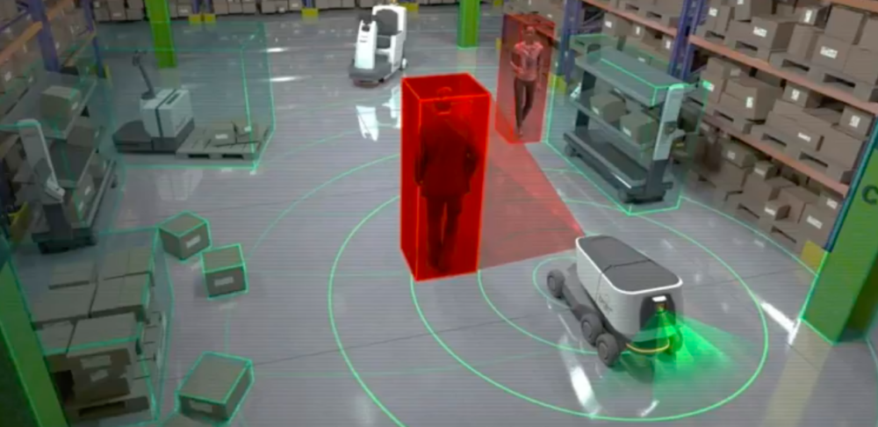
Chapter 1: Robotics Basics
Chapter 3: Control System
Chapter 2: Introduction to Industrial Arm
Chapter 4: Robot Navigation
Chapter 5: Robot Learning

Slide 3
Syllabus
Chapter | Description | Class
1 . Robotics Basics | Definition of Robot, Robotics, Roboticity, Autonomy, Laws of Robotics, Types of robots, Paradigms, Subsystem | 1 - 4
2 . Introduction to Industrial Arm | Manipulator Types, Forward Kinematics, Inverse Kinematics | 5 - 8
3 . Control System | Types of Control, Block diagram solving, PID control, Fuzzy Logic Control | 9 - 12
4. Robot Navigation | Path Planning, Localization, Mapping, Exploration | 13 - 14
5 . Robot Learning | Machine Learning Reinforcement Learning Computer Vision | 15 - 18

Slide 4
Marks Distribution
Quizzes/Class Tests: 15%
Assignment and surprise test: 5%
Attendance : 5%
Mid Term Examination: 20%
Final Examination: 30%
Lab: 15%
Project: 10%
Total: 100%

Slide 5
What is a robot?

Slide 6
What is a robot?
An embodied agent that can be programmed to perform physical tasks.
Notes:
Tangible presence + sensors

Slide 7
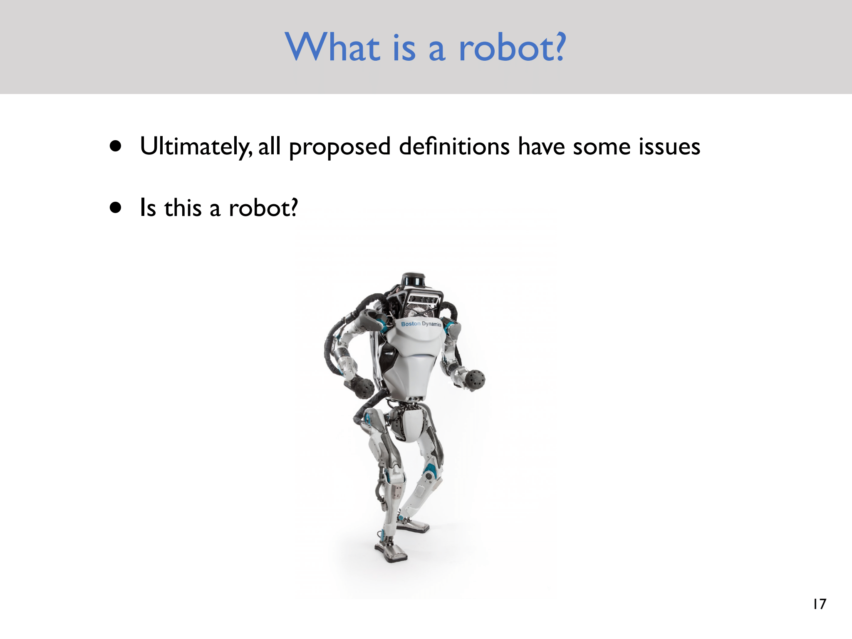

Slide 8
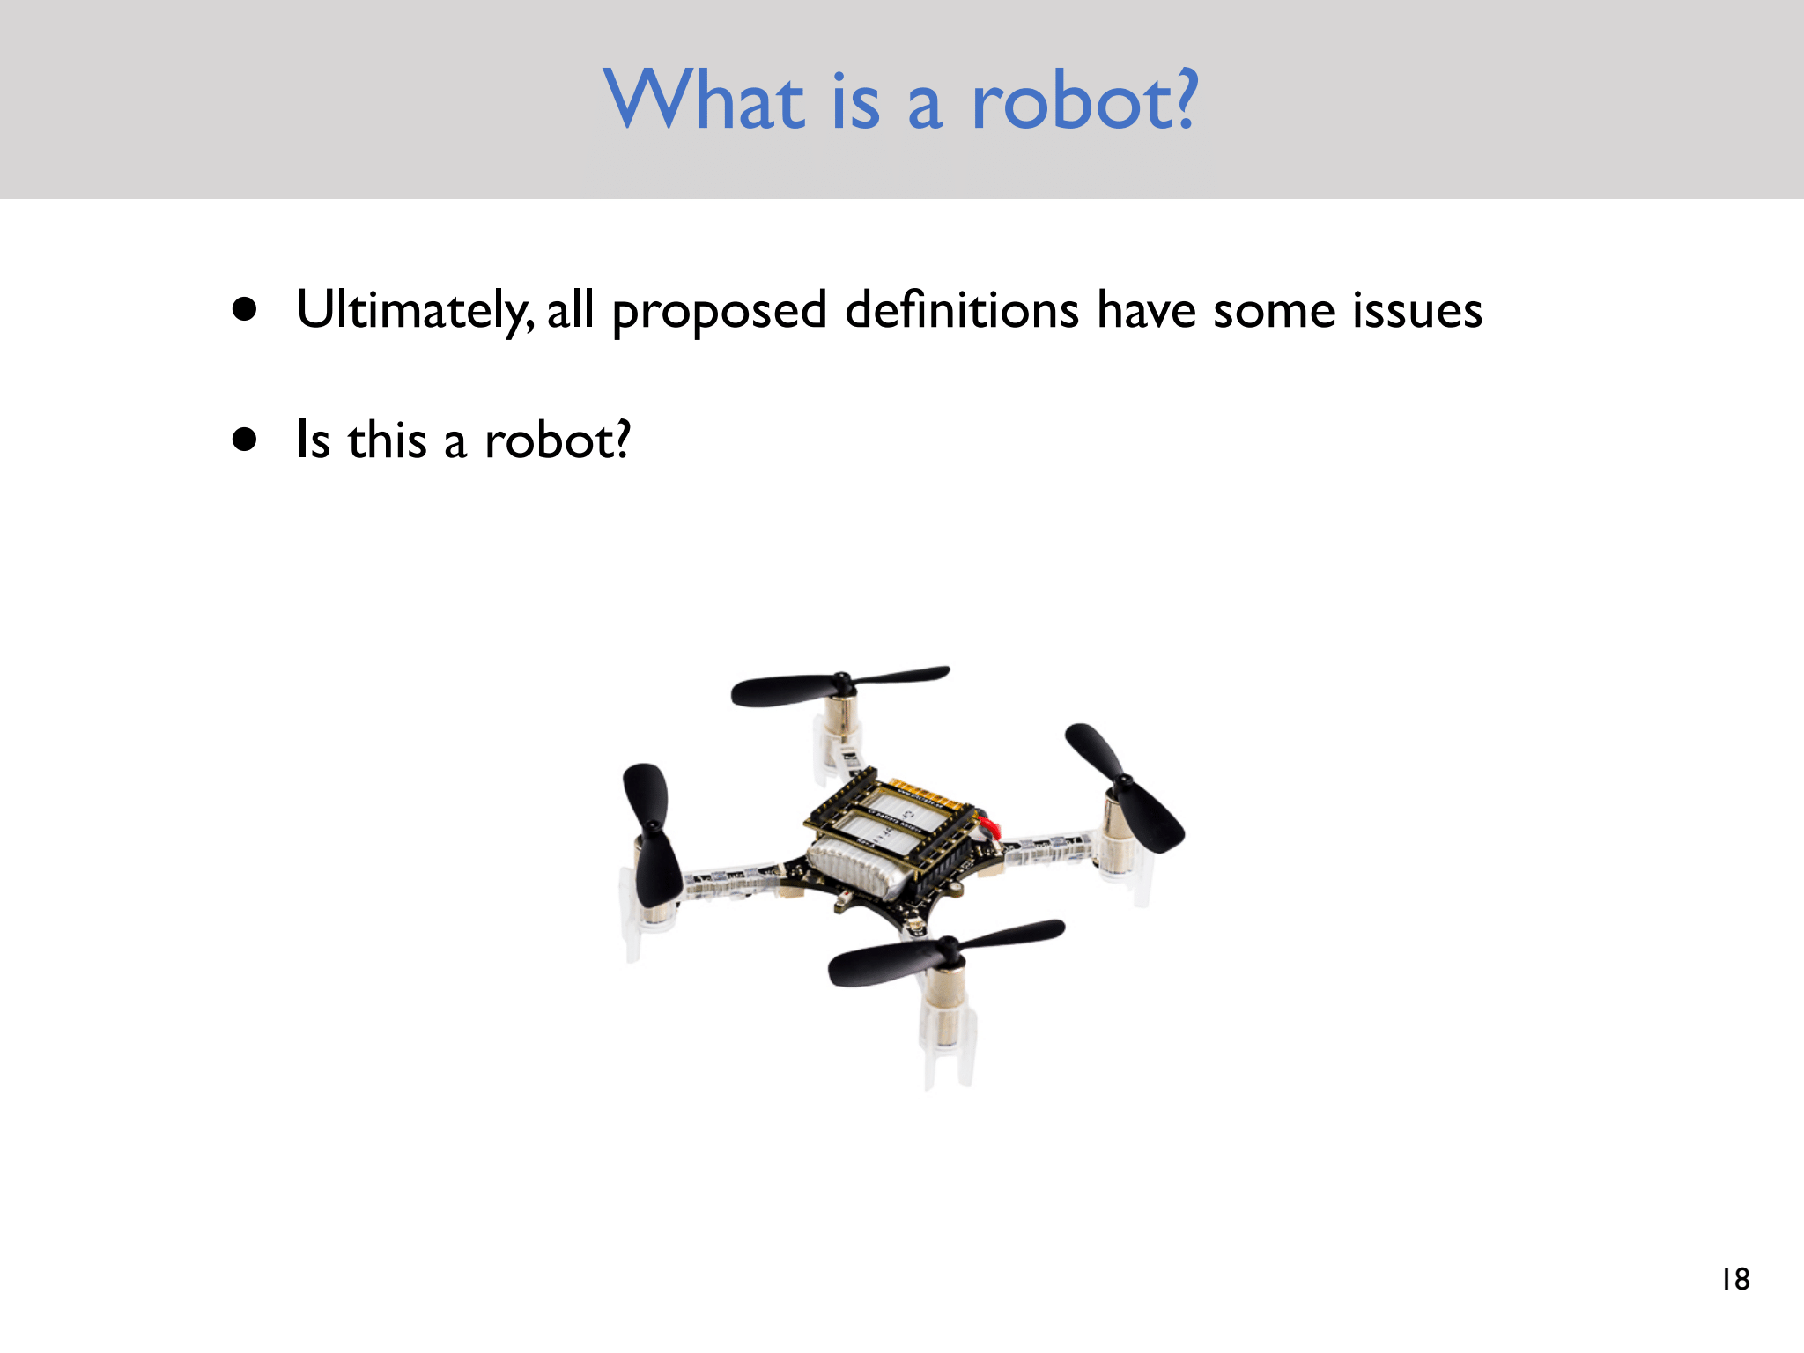

Slide 9
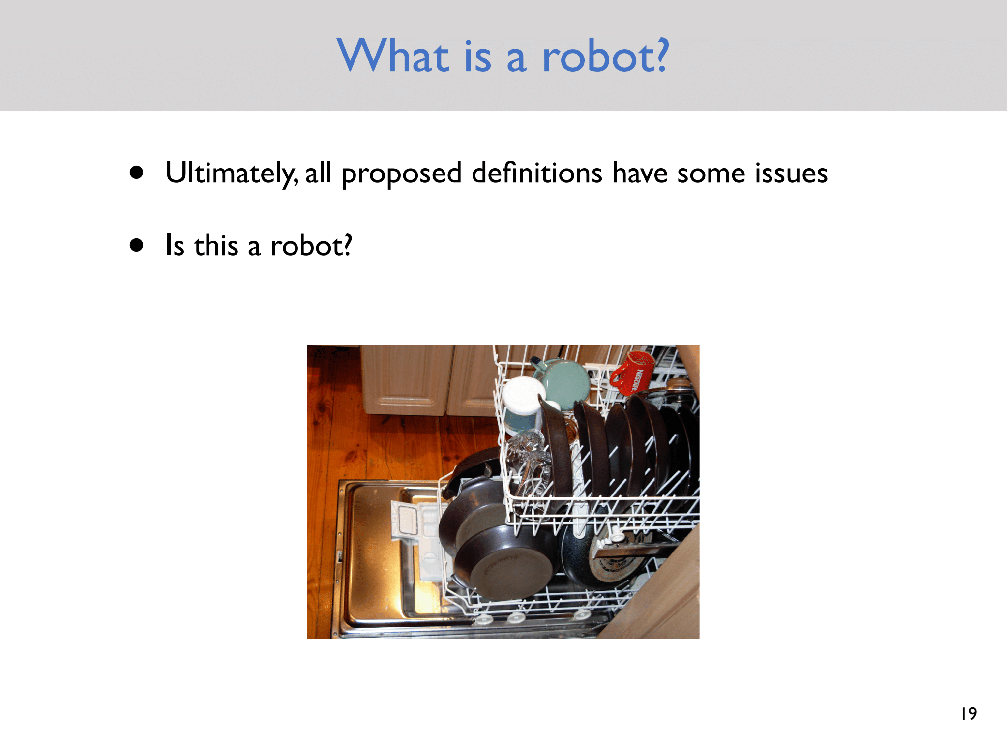

Slide 10
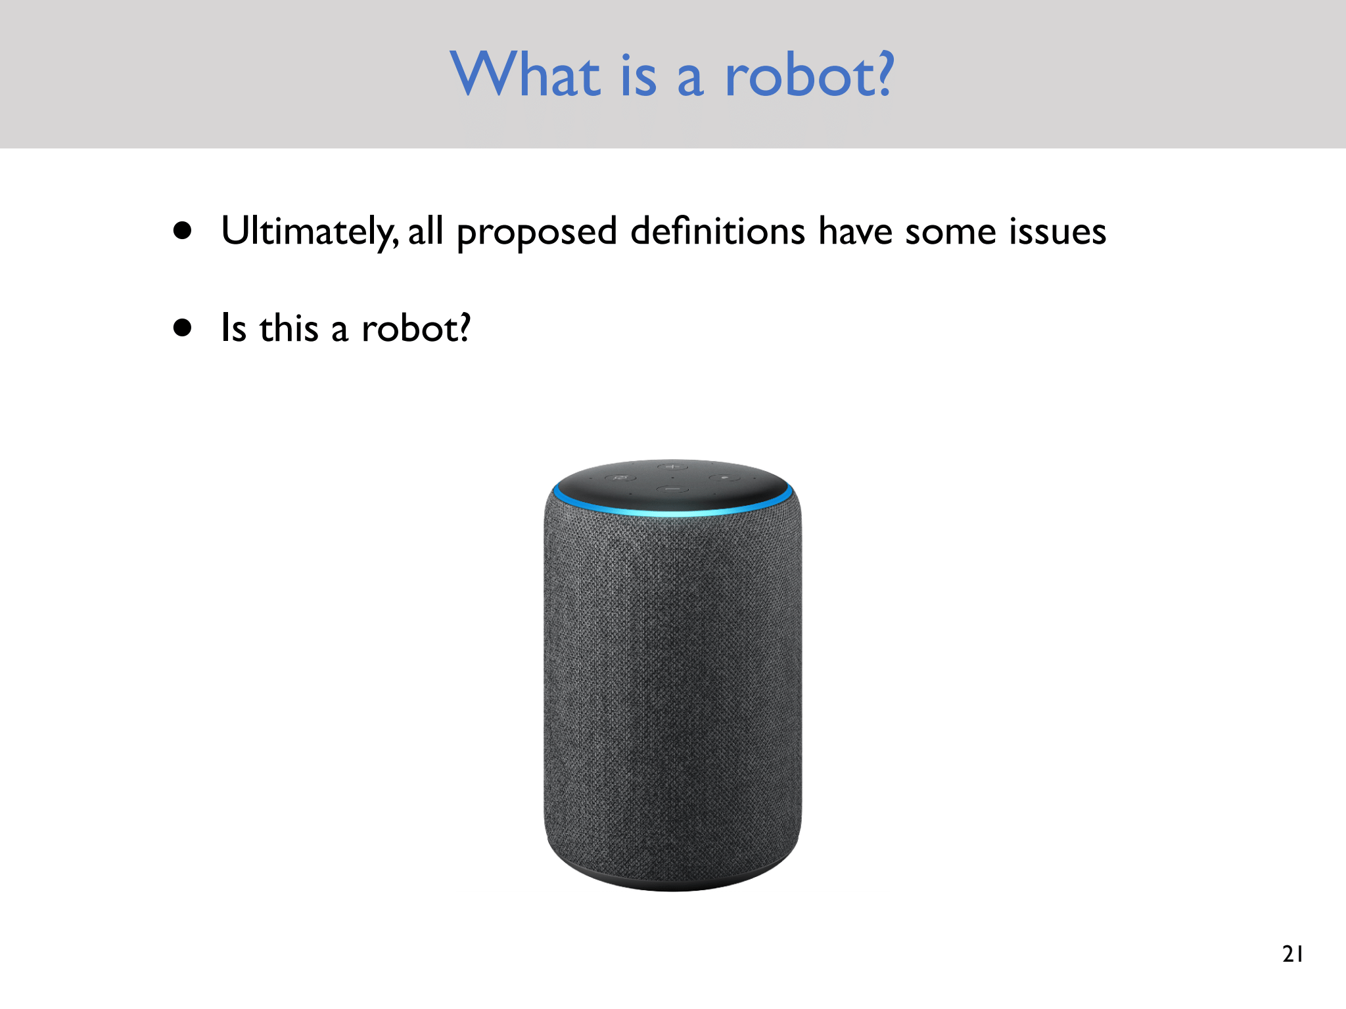

Slide 11
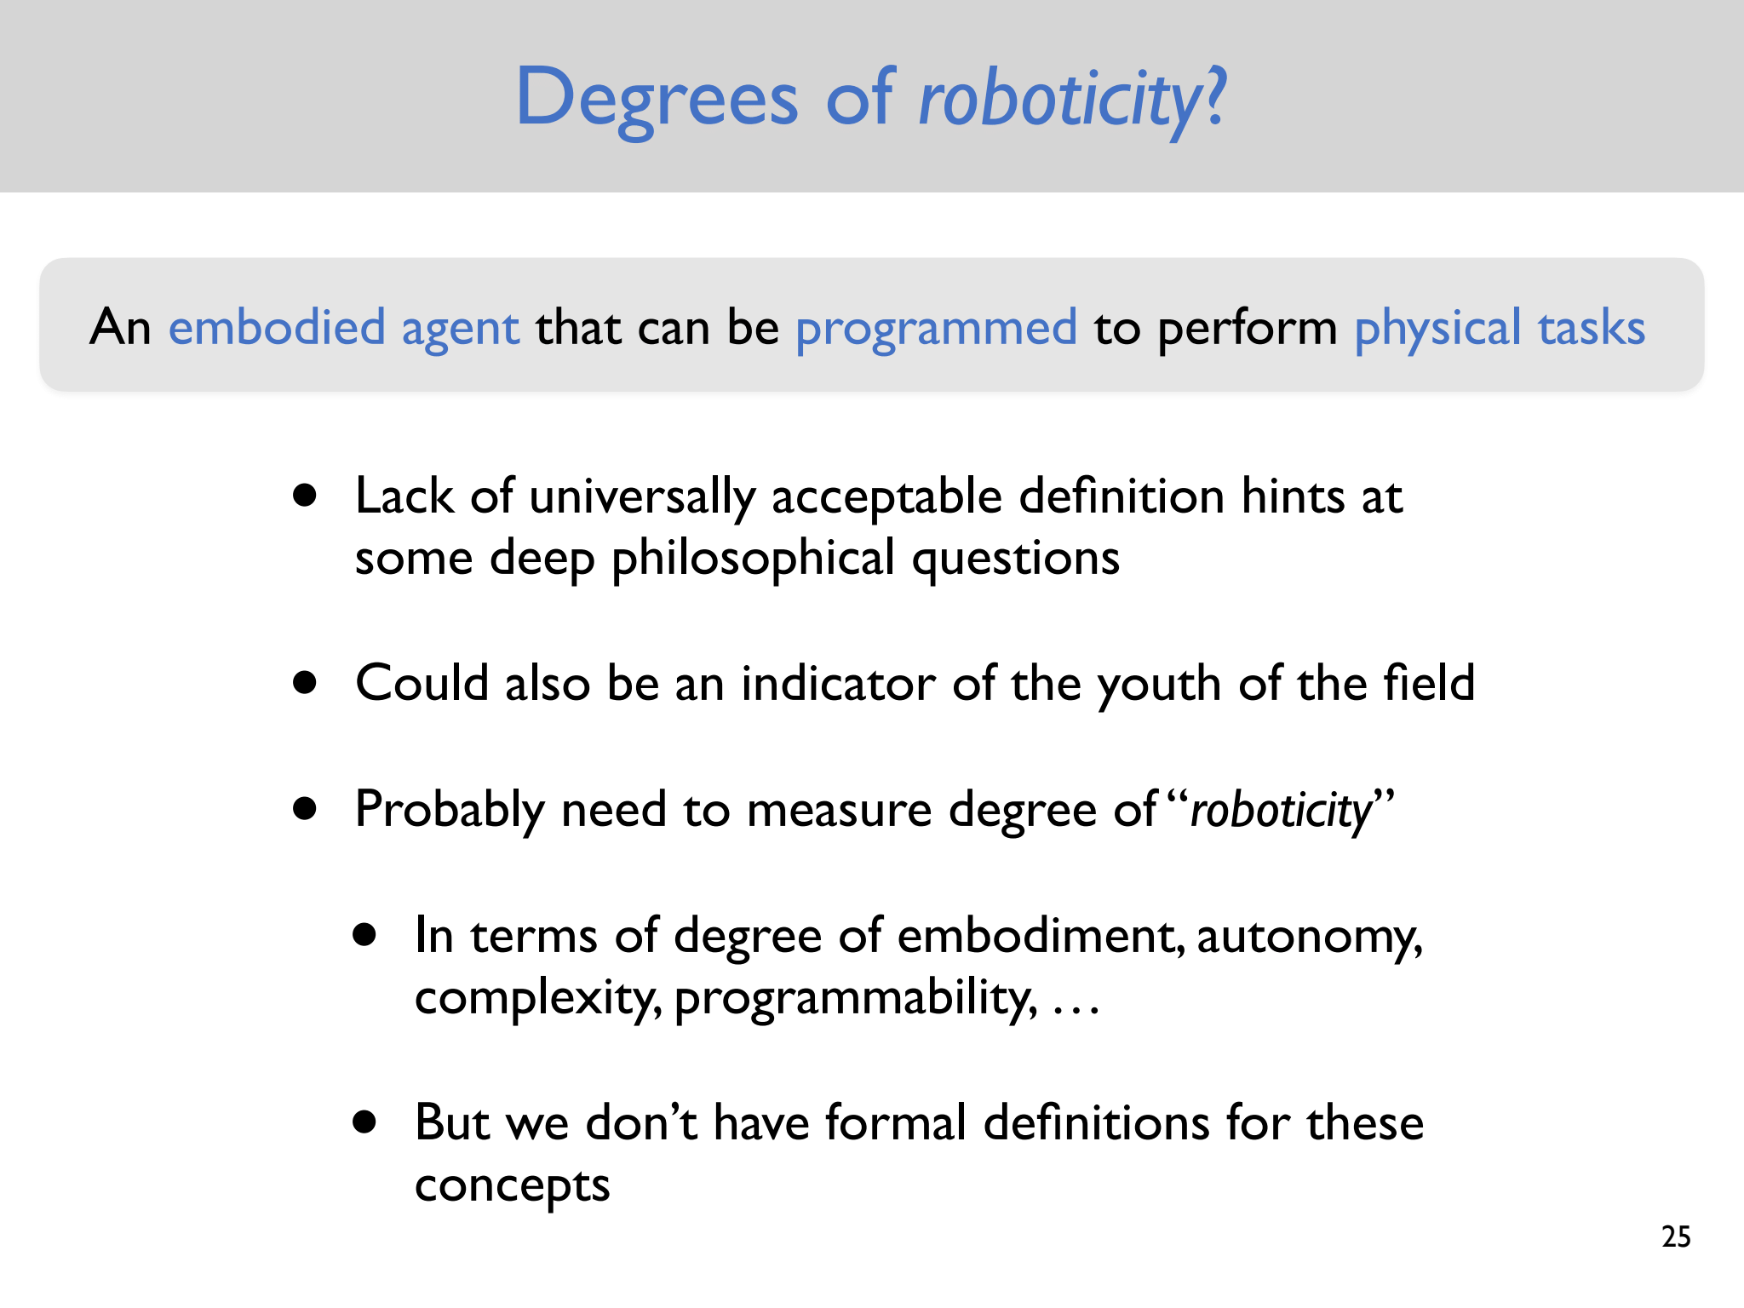

Slide 12
Robotics
Robotics is a branch of engineering and computer science that deals with the design, construction, operation, and use of robots.

Slide 13
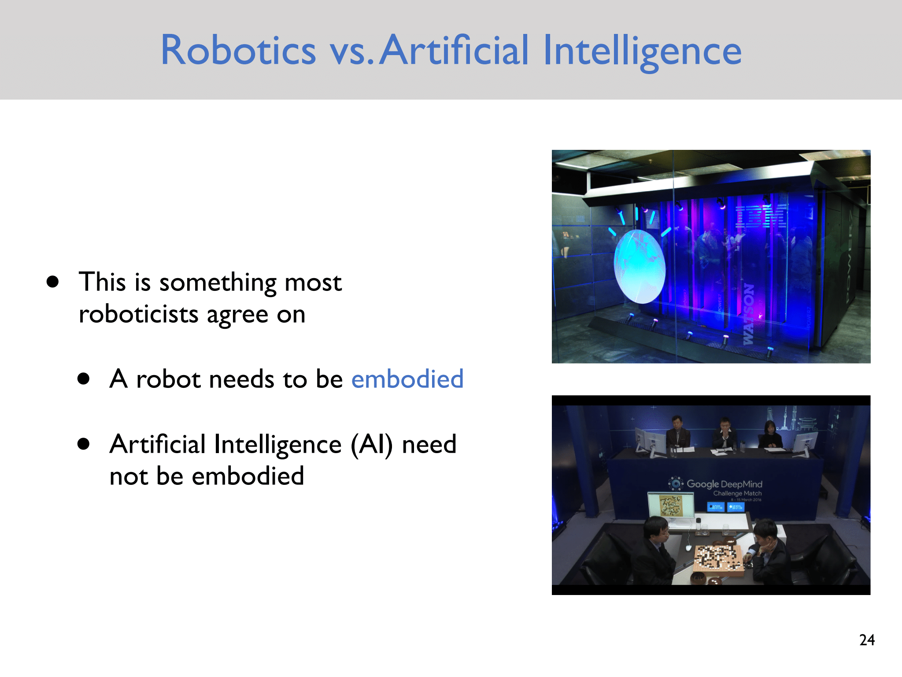

Slide 14

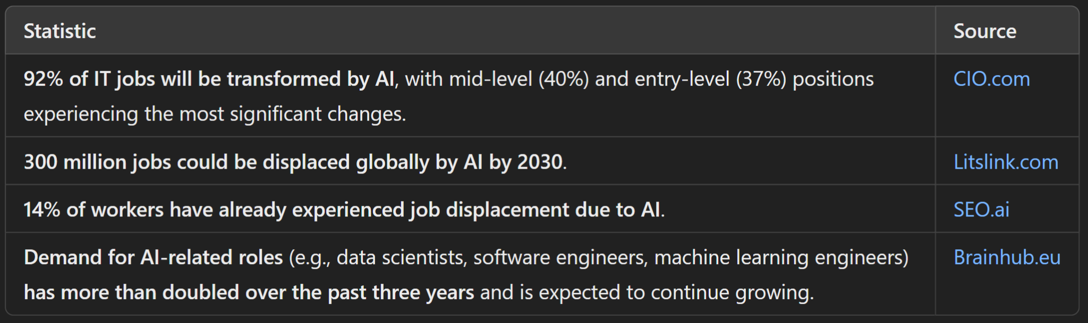
AI is Replacing Us!
AI can now make reasoning better than human , with long context documents
AlphaProof by DeepMind → solved 4/ 6 IMO problems 2024, equivalent to silver medalist
OpenAI's o3 Model: Codeforces ranking 2727!Better than 99.8% human

Slide 15
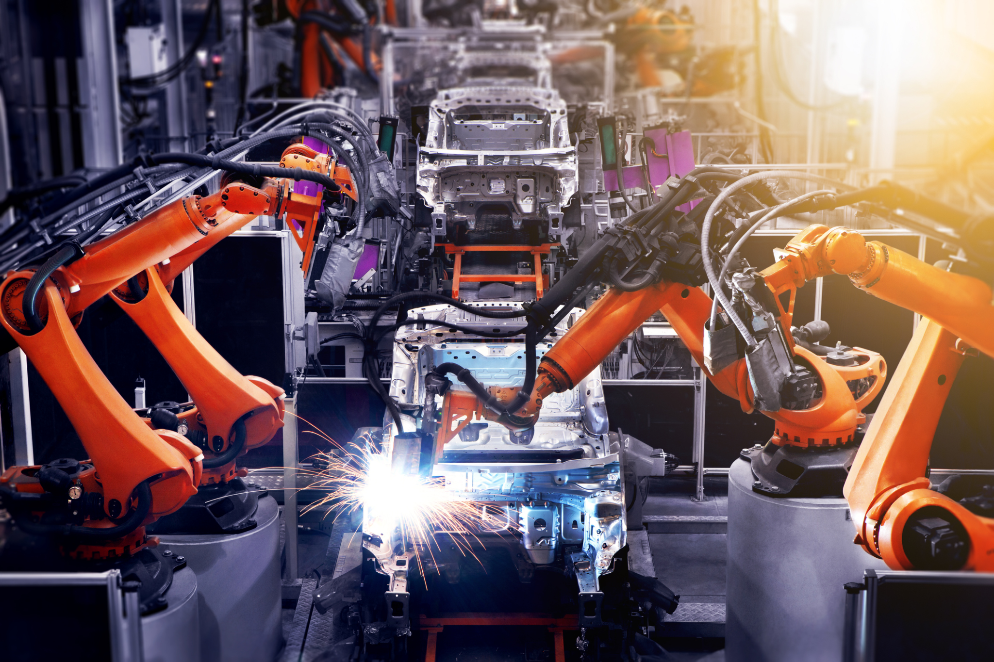
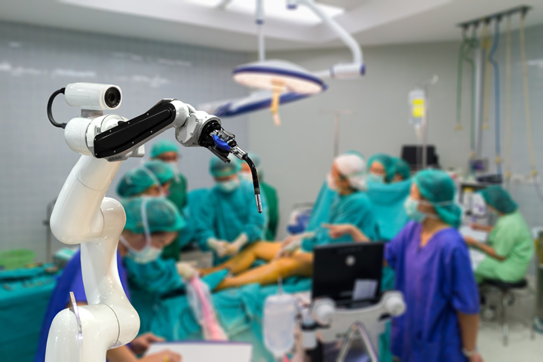
AI + Robotics?

Slide 16
How Robots Are Used Across Industries
Industrial
Farming and Agriculture
Healthcare
Logistics
Family Robots

Slide 17
Think of some features for your own family robot !
https://www.youtube.com/watch?v=-e1_QhJ1EhQ

Slide 18
Next Class
Laws of Robotics
Primitives
Paradigms
Notes:
Primitive → low level functionalities

Slide 19
Thank You

